Slide 1
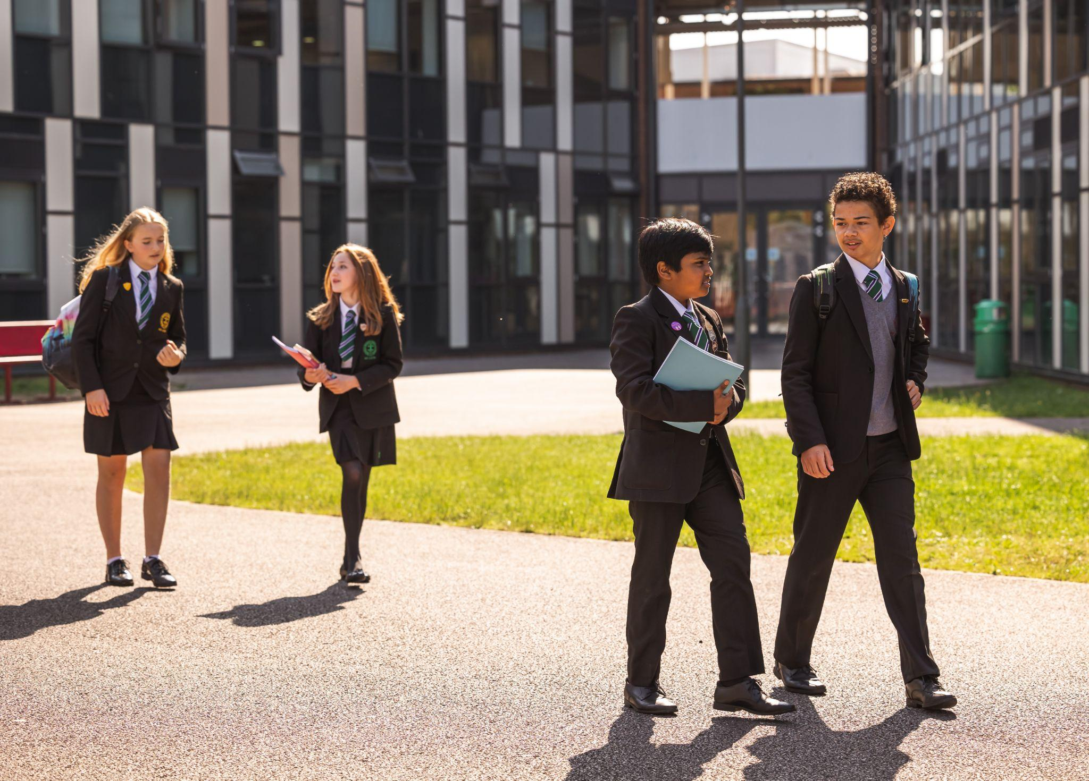
Y7 Information Evening
September 4, 2024

Slide 2
WELCOME
Kelly Thorne
kthorne@stbarts.co.uk
Assistant Headteacher - Key Stage 3 Raising Achievement
Adam Robbins
arobbins@stbarts.co.uk
Deputy Headteacher - Curriculum & Achievement

Slide 3
Our Values

Slide 4
Support and Guidance
Tutor
House Office
Teachers
‘Tell Someone’ (RM Unify)
Personalised Learning
Safeguarding
ELSAs (Emotional Literacy Support Assistants)
MHST, Berkshire Youth, Young Carers
Anti-Bullying Ambassadors

Slide 5
Communication
Tutor
House Office
curnockoffice@stbarts.co.uk
davisoffice@stbarts.co.uk
eversoffice@stbarts.co.uk
pattersonoffice@stbarts.co.uk
For general enquiries: office@stbarts.co.uk
‘Settling-In’ Evening - Tuesday 15th October

Slide 6
Punctuality & Attendance
Tutors rooms for 8:30am
Medical appointments
Requests for leave of absence (including holidays)
Attendance (%) | Number of days missed in a year | Number of students | Grades gained compared to expected outcomes
<90 | 20+ | 29 | 4
between 90 - 95 | between 11 - 20 | 40 | 0
between 95 - 99 | between 3-10 | 112 | 6
>99 | 2 or fewer | 66 | 7
% attendance has a significant impact on the overall progress, even below 95%

Slide 7
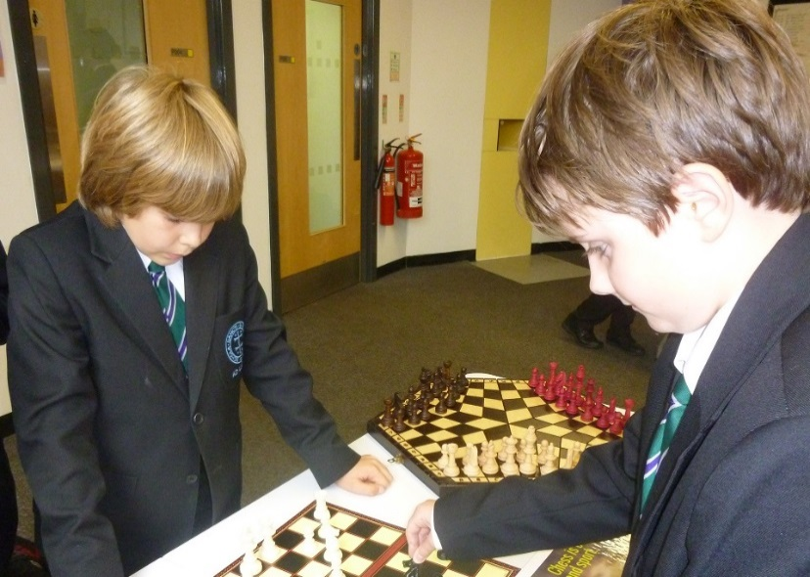
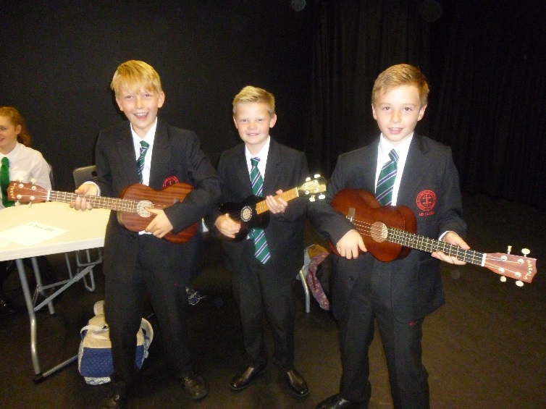
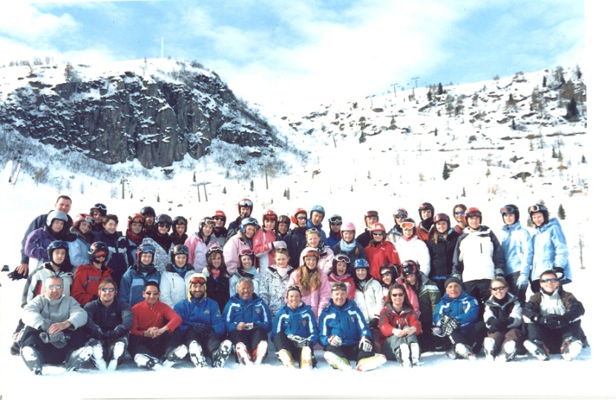
Co-Curricular Opportunities
Language trips
Expeditions
WW1 Battle Sites
Ski trip
Outdoor Activities
CCF and DoE

Slide 8
Enrichment & Assemblies
Year Group Assembly every week
House Assembly - am every week and pm every 3 weeks
Whole School Assembly every 3 weeks
PD (Personal Development) weekly
Growth mindset & resilience
Emotional health
Friendships
Themes around inclusion and diversity running through our curriculum
Student voice via the School Council

Slide 9
Year 7 Team Building
An opportunity for all students to take part in a team building day with their tutor and tutor group
C&D - Thursday 19th Sept.
E&P - Thursday 26th Sept.
Specific Information about the day will be coming

Slide 10
We love reading!
Everyone loves a good story
Reading is hugely important for progress at secondary school
Enjoyment and relaxation; building empathy and vocabulary
Thursday tutor time: reading for pleasure with tutors
Read, discuss, enjoy!

Slide 11
Advice for parents

Slide 12
Advice for parents

Slide 13
What else is heading Y7’s way
Ele Fountain - author of Boy 87, Lost, Fake, and Wild
Scholastic book fair in November
Various other reading activities
School access to the i newspaper
Library lessons every other week
Feel free to use the library at break times – it’s there for you
Mrs Hewetson

Slide 14
The Curriculum

Slide 15
Curriculum
Centrality of curriculum – Ofsted focus
Key cross-curricular themes across subjects
Literacy
Numeracy
Careers
Personal Development
Curriculum coherence
Notes:
JPS

Slide 16
Curriculum Structure
Subject | Year 7 | Year 8 | Year 9
English | 4 hours | 3 hours | 4 hours
Maths | 3 hours | 4 hours | 4 hours
Science | 3 hours | 3 hours | 3 hours
History | 2 hours | 1.5 hours | 2 hours (+2 hours option)
Geography | 2 hours | 1.5 hours
MFL | 2 hours | 3 hours | 3 hours
Design Technology | 2 hours | 2 hours | 2 hours
Computing | 1 hour | 1 hour
Art | 1 hour | 1 hour | 2 hours (+2 hours option)
Music | 1 hour | 1 hour
Drama/Dance | 1 hour | 1 hour
PE | 2 hours | 2 hours | 2 hours
RE | 1 hour | 1 hour | 1 hour
PDP | 1 hour | 1 hour | 1 hour
Notes:
JPS

Slide 17
Teaching Groups
The Tutor Group
Students are banded by ability in some subjects.
Year 7
Maths (Banded from September)
PE (Banded September/October)
Languages (Banded from January)
Year 8
English ( Banded from September)
Year 9
Subject choice introduced in Languages, Humanities, Expressive Arts and Design Technology
Fluidity of movement between groups to reflect different rates of progress.
Notes:
JPS

Slide 18
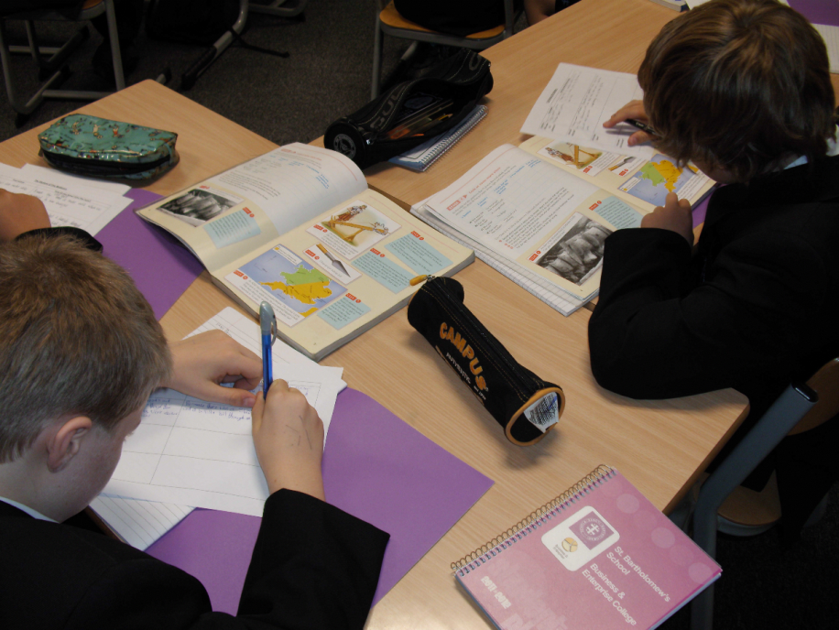
Monitoring your child’s learning
Discussing work with your child
Reading exercise books
Reinforcing guidance from teachers
Supporting your child in responding to feedback
Monitoring & supporting homework
Ask your child to explain what they are learning and why?
Notes:
JPS

Slide 19
Communication
Website
The Termly Calendar
BartholoNews
Emails/letters from school
Social media (Facebook, Twitter and Instagram)

Slide 20
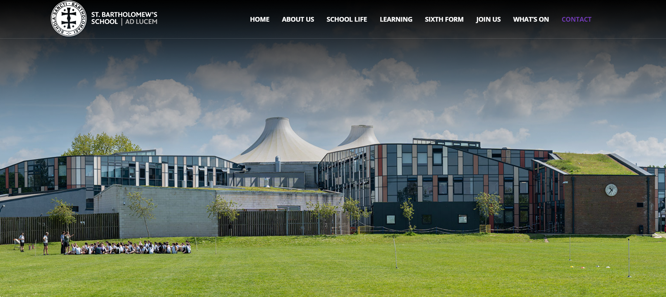
New Website:
Please refer to the main Contact page
Find email addresses of all teaching staff.

Slide 21
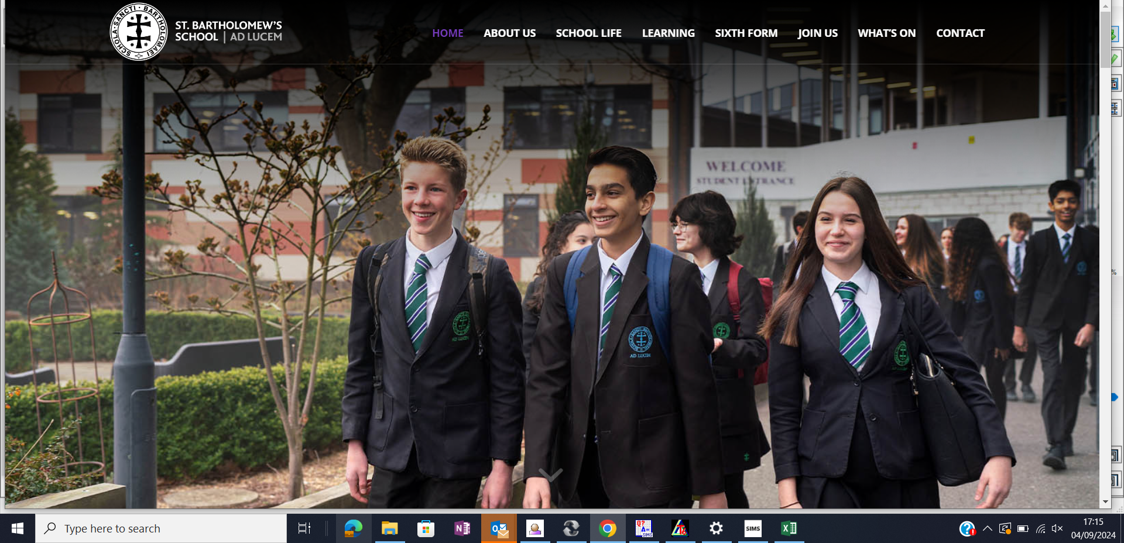
Making contact after Monday!

Slide 22
Monitoring Progress
Reports - December 10th & July 8th
Parents’ Evening - April 30th

Slide 23
Reporting On Your Child’s Progress
Two detailed reports per year (Dec and June)
Key summary data
Parents’ Evening (April)
We feedback on students performance in the following key areas:
Engagement in Learning
Quality of Homework
Organisation
Behaviour

Slide 24
Comparison with national data
 |  | % A/7 + | % C/4 + | % pass
St Bart's Total | 2024 | 35.0 | 83.0 | 98.9
National Total |  | 21.7 | 67.4 | 98.0
Residual |  | 13.3 | 15.6 | 0.9

Slide 25
Homework

Slide 26
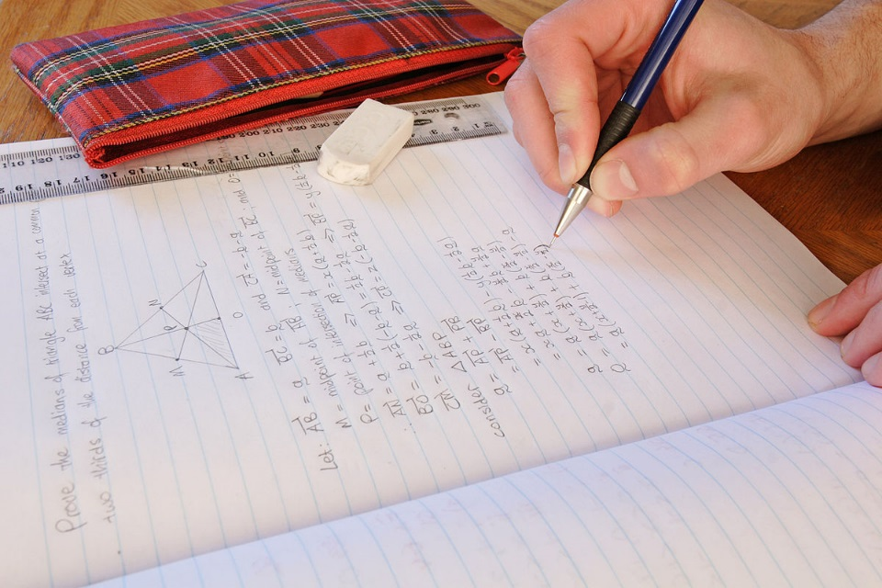
Homework counts
Analysis of value-added by homework scores in Y11
The quality of homework is strongly
linked to overall progress.
Each piece of Homework can last up to 30 minutes. English Homework may be up to 45 minutes
Average Homework score from Y11 reports | # | P8 score | number of grades above or below national expectations
better than 2 | 117 | 1.03 | 10
between 2 and 2.5 | 68 | 0.29 | 3
between 2.5 and 3 | 44 | 0.07 | 1
below 3 | 44 | -1.36 | -14
Notes:
JPS

Slide 27
Homework Tasks
Written tasks
Reading
Research
Interviews
Drawing
Internet based
Extended independent study tasks
Notes:
JPS

Slide 28
Satchel:One
All Homework is shared with students via the Satchel:One platform
All students can log in to SMHW by using their school network details through RMUnify. This allows them to see just the homework set for their classes.
Notifications
Task published
Tasks marked as not submitted
Detentions
Grade added
Teachers may update Satchel One to show the ‘submission status’ of the Homework tasks that have been set. Students may also be issued with a Satchel One Detention if they fail to ‘submit’ their Homework without a valid reason. These ‘Detentions’ are run at Activity Times in school, and are there to support students with their Homework.
Notes:
JPS

Slide 29
Satchel:One
Notes:
JPS

Slide 30
Monitoring & Supporting Homework
Checking Satchel:One
Discussing tasks
Supporting completion
Time management
Supportive environment
Balancing activities
Reading with your
child

Slide 31
Chromebooks

Slide 32
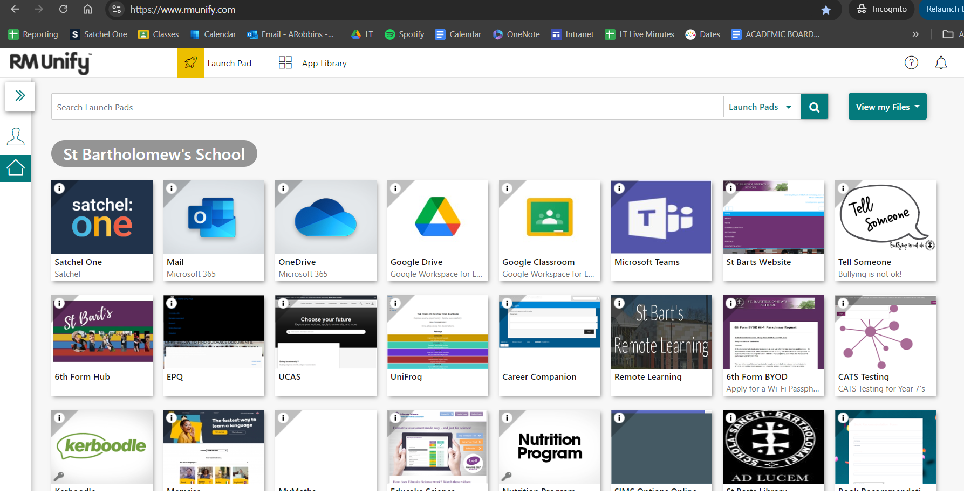

Slide 33
Information Technology/Remote Learning
Microsoft Outlook
Microsoft Teams
Satchel: One
Google Classroom (Google Drive)
RMUnify
OneNote

Slide 34
Parents’ Association
AGM 18/09/24
Uniform Shop open 2.45 each Friday.

