Slide 1
Year 10
Information Evening
Mr Robbins: Deputy Headteacher Curriculum and Achievement
Mrs Cordiner: Assistant Headteacher
KS4 Progress and Achievement

Slide 2
Summary of the evening
Mr Robbins
Timeline
New Website
subject information
contacts
Reports
Grading
Next Steps
Mrs Cordiner
Homework
Organisation
Revision
Parental Support
Attendance
Wellbeing

Slide 3
Y10 Timeline
AUTUMN |  | SPRING |  | SUMMER
14-24/10 - Window for requesting subject changes | 27/11 - Reports 02-11/12 - Window for requesting KS4 Extra choices |  | 04/03- Parents Evening 11-14/03 Practice Exams: English, Maths, Science & 1 Option 07/04- Reports | Practice Exams in Option Subjects | 15/07- Reports

Slide 4
Y11 Timeline
AUTUMN |  | SPRING |  | SUMMER
Oct - Parents Evening (1) | Sixth Form Applications Practice Exams Dec - Reports | Jan - Parents’ Evening (2) | March - Reports Release of NEA marks | May-June Exams

Slide 5
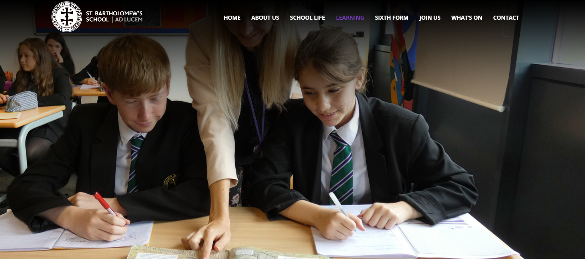
Website page : Review of Learning, Y10-Y11
Website pages: Subject guides including links to all exam board specifications etc.

Slide 6
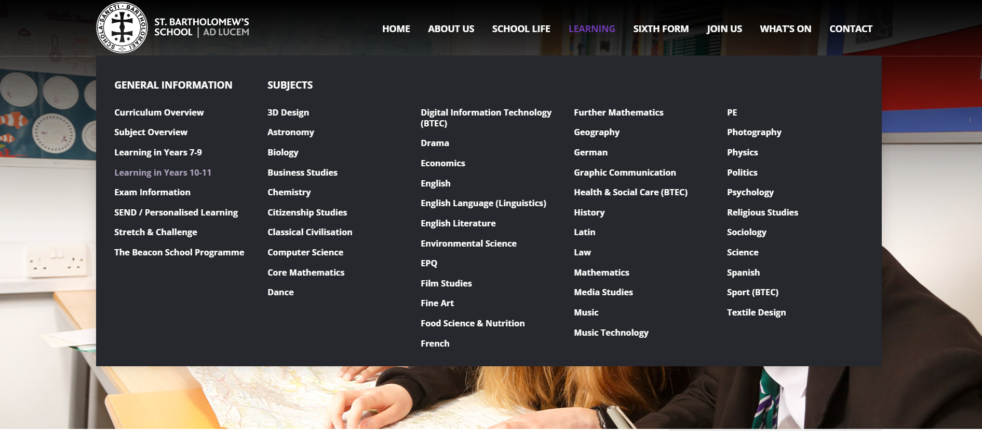
New Website:Click on the Learning Tab to access subject guides (including links to exam board specifications.

Slide 7
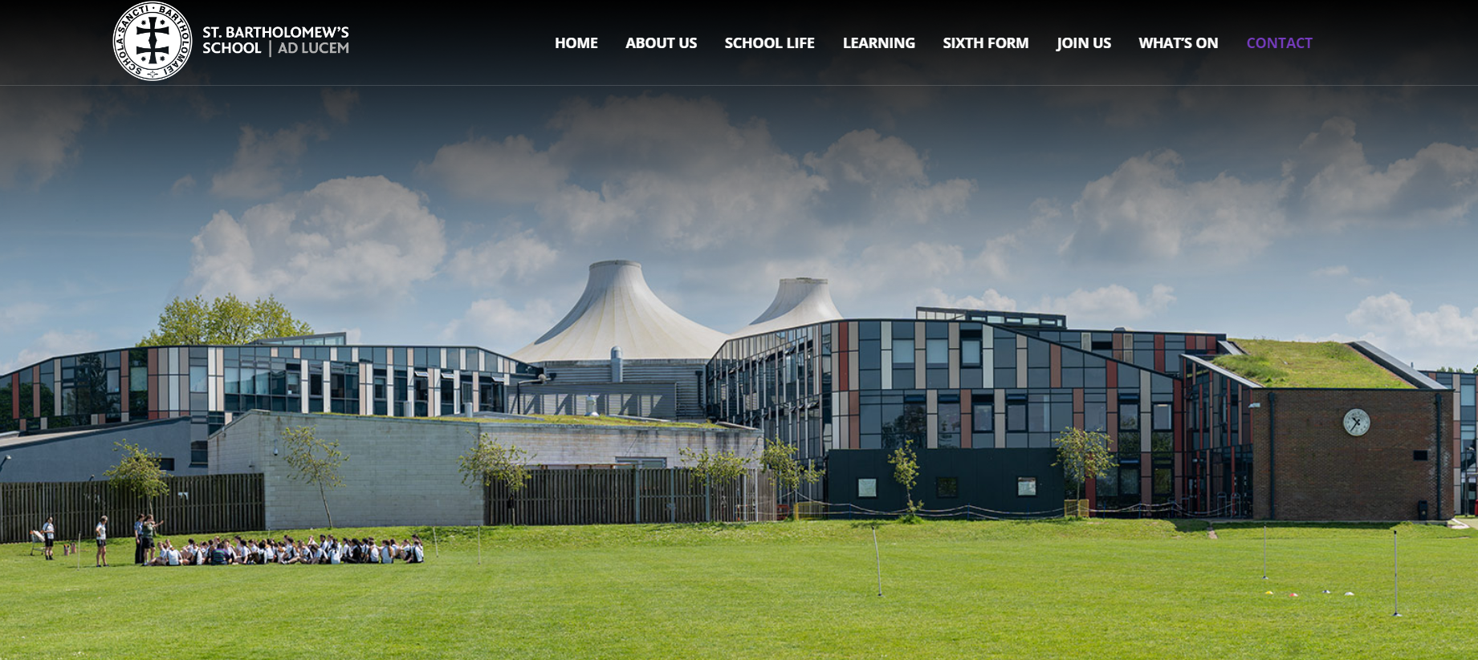
New Website:
Please refer to the main Contact page
Find email addresses of all teaching staff.

Slide 8
Reports
In Year 10 and 11 we give an indication of the student’s ‘Most Likely Outcome’ (MLO) in each subject.
Excellent Progress
Good progress
Minimum expected progress
Less than expected progress
Unsatisfactory progress

Slide 9
GRADING
GCSEs
In all GCSE subjects the grading is on a 9-1 scale and the grade can be further refined with + or – signs (e.g. 5+ or 5-).
For GCSE Combined Science, the grade is reported as a double grade (e.g. 5-6 or 6-6) as the qualification awards two GCSEs.
BTEC TECH AWARDS
Level 2 / Distinction* D*2
Level 2 / Distinction D2
Level 2 / Merit M2
Level 2 / Pass P2
Level 1 / Distinction D1
Level 1 / Merit M1
Level 1 / Pass P1

Slide 10
Sixth Form Entry

Slide 11
Start of Year 10
Students have chosen their options
Enrichment activities on Friday afternoons
Taking ownership of their learning
Changes in lesson tempo and content, with an increased focus on exams
Increased emphasis on managing their own workload

Slide 12
Homework
Analysis from the 2024 GCSE results shows a direct correlation between HWK/ Effort and outcomes
Use Satchel One to monitor homework set and due dates.
Consider creating a personal homework timetable.
Speak to the teacher if there are any issues.

Slide 13
Organisation
Students must remember their books and key equipment for lessons, including HWK.
Ensuring that students have the notes and resources to come back to later on.
Homework folders are useful.
Chromebooks should be charged and brought into school everyday. Notes and work should be organised.

Slide 14
Overcoming challenges and developing resilience
Things will start to become more challenging
We encourage all students to be ambitious and brave
Adopting a growth mindset and a ‘can do’ attitude
Reassure them that it is ok to occasionally feel overwhelmed and take a step back to reset.
The more effort they put into Year 10, the easier Year 11 will feel.

Slide 15
Revision
Teachers may start setting revision for HWK
We will be exploring ‘how to revise’ with our students, particularly in the lead up to their end of year exams in the summer.
Do they need to start revising now? They should be revising for upcoming assessments and revisiting their notes from previous lessons.
A few helpful tips….

Slide 16
Revision
Revision isn’t just about rewriting notes, they should be doing something with that information such as:
Creating flash cards, mind maps, recording voice notes or answering past paper questions
Students shouldn’t be revising for hours at a time. They need regular breaks. 20 minute bursts.
Should take place in a quiet space, ideally not a bedroom.
Limit distractions such as phones.
A revision/ HWK timetable might be useful
Email your child’s teacher- we are here to help!

Slide 17
Parental Support
Monitor homework, not just whether it is being completed but the quality of the homework
Discussions following reports, contacting individual teachers where necessary
Ensure that they take a break when studying, eat a healthy diet and get plenty of sleep.
Catch them being good
Model good habits
Encourage them to continue with extracurricular activities.
Work with the school to support them and contact the school if you are concerned.

Slide 18
What makes a good learner?
Self-regulated learning: apply their learning, know how to approach things, know what they do and don’t know
Self-efficacy: a student’s belief in their own ability to perform – impact on motivation
Motivation: extent to which a student wants to learn

Slide 19
Parental Support. I can’t get my child to revise…
Start with ensuring all homework is completed
Then start with revision for one or two subjects; potentially core subjects or something they enjoy or feel good at
Short bursts of revision
Start having discussions about post 16 options
Engage with them on their learning- ask questions, learn with them.

Slide 20
Importance of Attendance
Each day a student is absent, they lose 5 lessons of learning.
Missed lessons = catch up = increased pressure
Informing the House Office if you have any concerns or require support with attendance related issues.
Good habits that are formed in September appear to be maintained throughout the academic year.
Setting the students up for success in the workplace.
Notes:
Importance of the teacher- the teacher will provide quality first teaching and in class support that cannot be replicated when studying at home.
When students have to catch up with missed work, in addition to HWK and any additional activities they complete both in and outside of school, this significantly increases their workload and may even damage their confidence in that particular subject as they feel they have fallen behind.
We have an excellent pastoral system to support your child throughout their education. Please do speak to the House Office if you have any concerns about your child's attendance.The House Office is also there to ensure that good attendance is maintained so may also contact you if they have any concerns.
Statistics show that students who form good attendance habits in September, are more likely to maintain that throughout the academic year. It’s important that students are motivated to get themselves into school and to learn, but they may need that extra little push from you as parents.
However, attendance isn’t only important for schools, it is important for all work places and by enforcing high standards, we are preparing our students for the work place and beyond. Developing their resilience and intrinsic motivation.

Slide 21
Attendance & St Bart’s GCSE Results 2024
% attendance in Y11 | # | P8 score | number of grades above or below national expectations
below 90% | 46 | -1.2 | -12
between 90% and 95% | 61 | 0.52 | 5
above 95% | 166 | 0.64 | 6

Slide 22
Absence across KS4 and performance at GCSE
Importance of Attendance
Notes:
It’s important to note that absence does have a direct impact on attendance. The graph on the screen shows attendance across KS4 (year 10 and 11) and how the individual days of absence can mount up to have a detrimental effect on performance at GCSE.

Slide 23
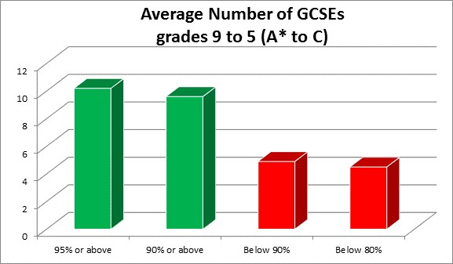
Importance of Attendance
Notes:
This additional graph simplifies t this information and shows that students who have attendance below 90% receive on average, fewer GCSE Grades

Slide 24
Student Wellbeing
Vital for success.
Encouraging resilience and a growth mindset.
Engaging with our co-curricular offers.
Our PDP programme will explore aspect of health and wellbeing in greater detail.
We appreciate that this can be a challenging period and are here to support.
We can provide both in house support and external support where necessary.
There are lots of excellent resources/websites for students and parents- please read Bartholonews and the school website

Slide 25
Student Wellbeing
The number one port of call is the Tutor, House and/or Personalised Learning department. Our staff are extremely experienced in supporting students
If additional support is needed can explore the need for the following services offered in school:
Counselling or talking therapy
School nurse
Mental Health Support Team
Youth Workers
SEMH worker
Pastoral Support worker

Slide 26
Thank you for your time.
Please leave any questions you might have in the Q&A box. We will answer these questions and upload responses onto the school website

